Slide 1
Synthesis of Snapping Fixtures
Tom Tsabar, Efi Fogel and Dan Halperin

Slide 2
Synthesis of Snapping Fixtures
overview
Background
Definitions
Properties
Basic algorithm

Slide 3
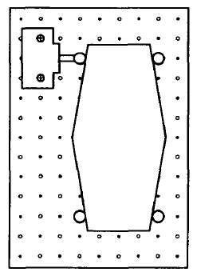
Synthesis of Snapping Fixtures
Background
Fixturing
Brost and Goldberg. 1994

Slide 4
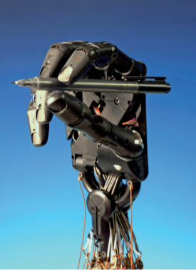
Synthesis of Snapping Fixtures
Background
Fixturing
Form Closure
Force Closure
Mishra, Schwartz, Sharir. 1987

Slide 5
Synthesis of Snapping Fixtures
Goal
Generating snapping single-piece fixtures for given polyhedra that can be assembled from a separated state
*Considering only linear translations

Slide 6
Synthesis of Snapping Fixtures
Definitions
Palm
Body
Gripper

Slide 7
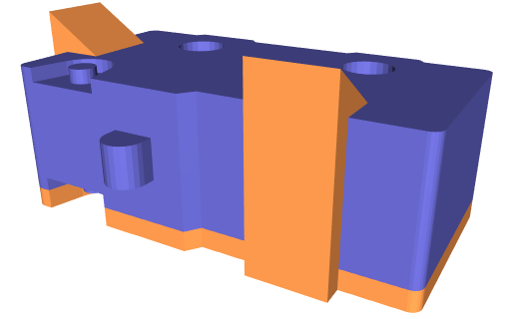
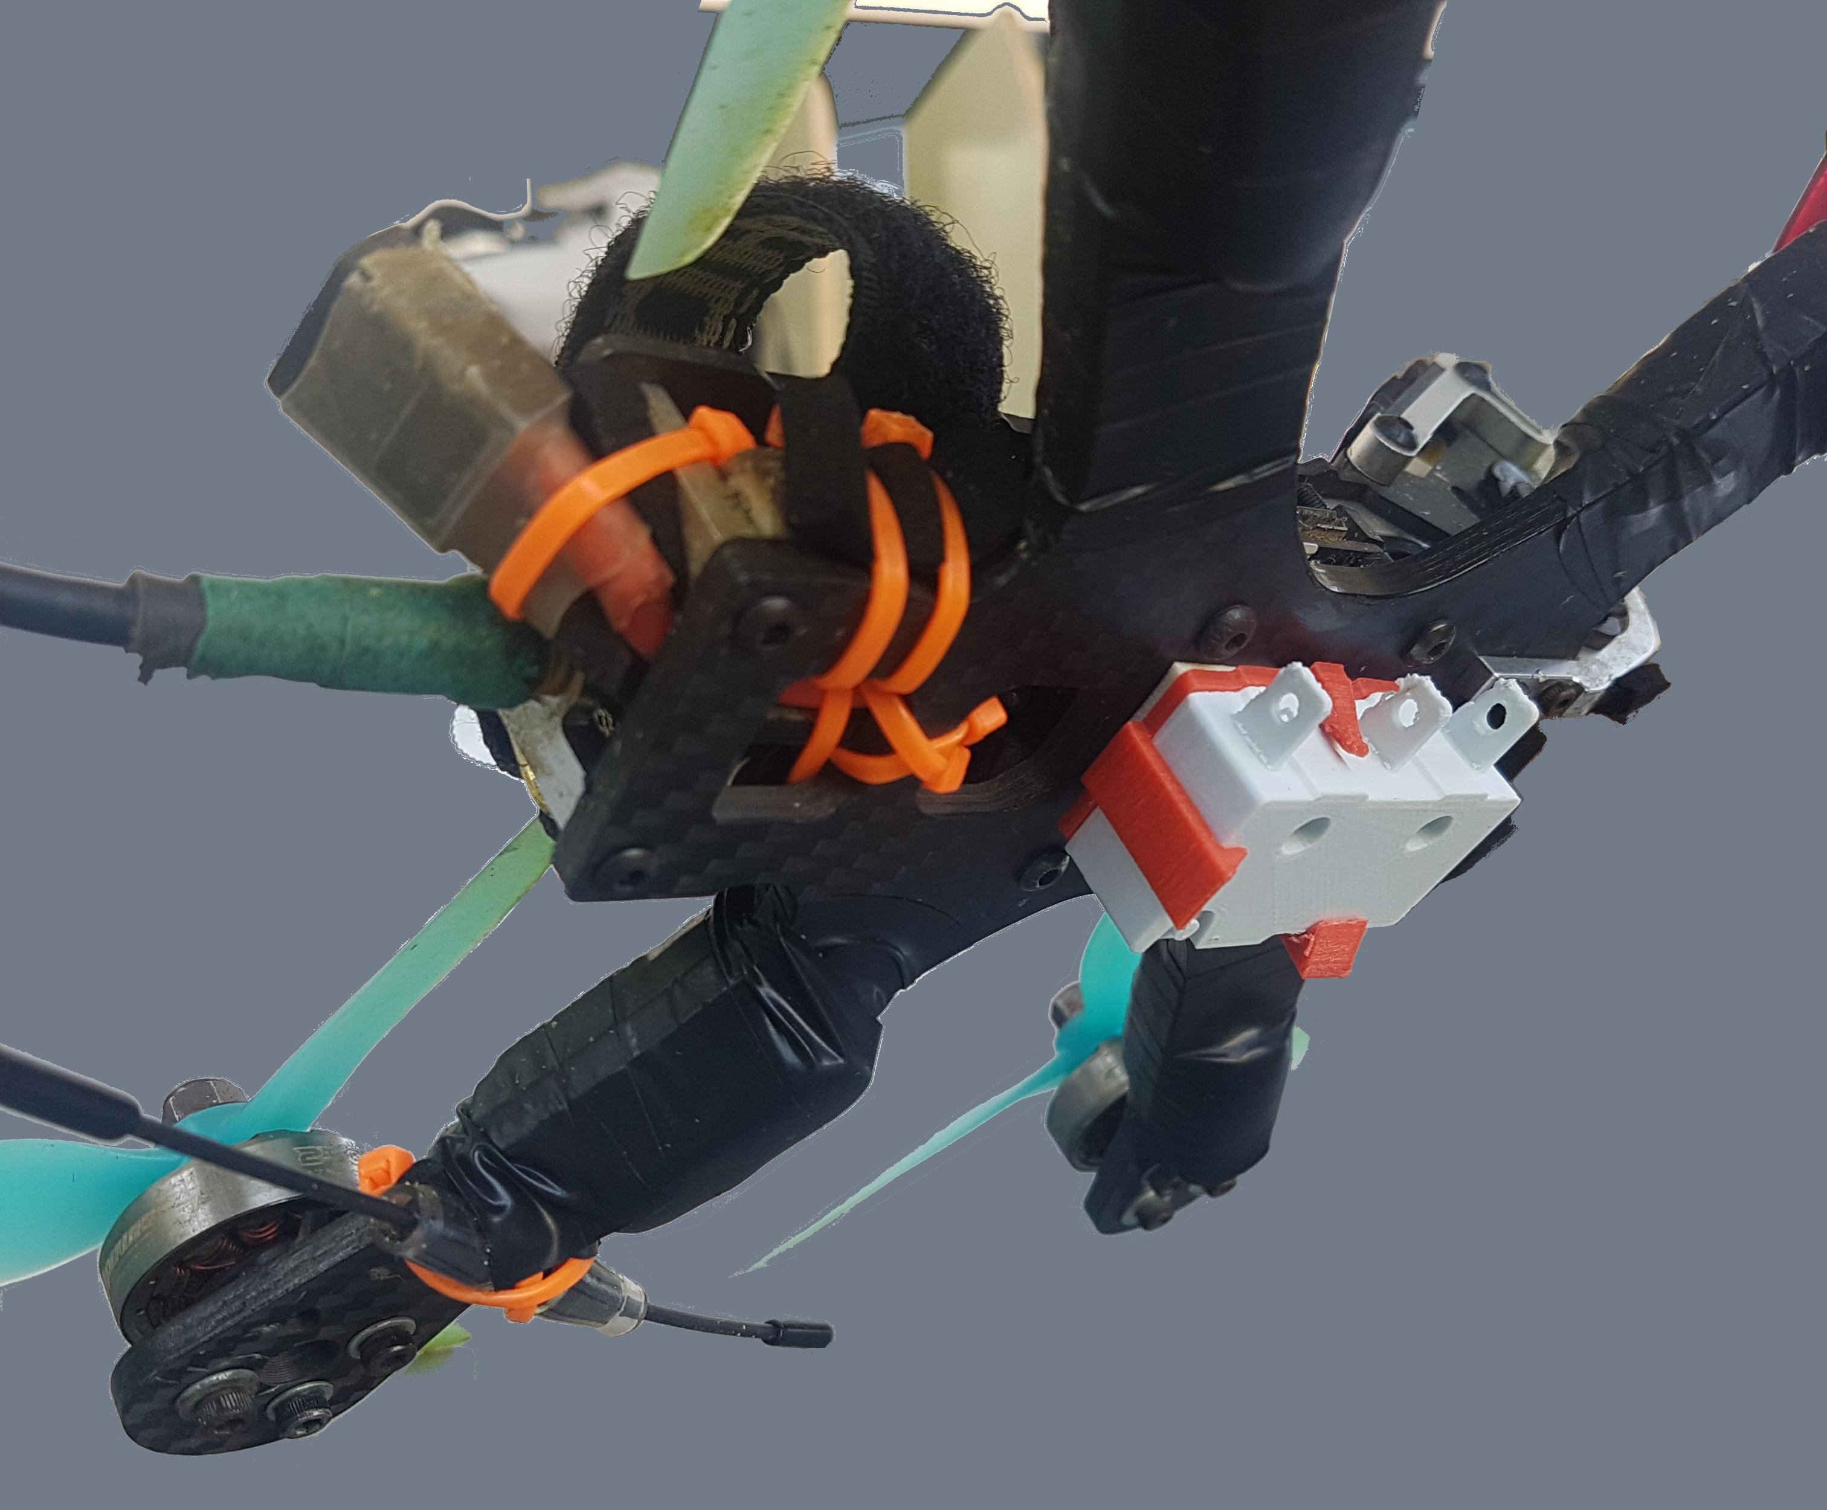
Synthesis of Snapping Fixtures
Use cases
Reducing weight

Slide 8
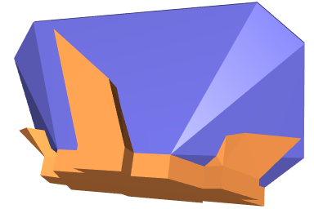
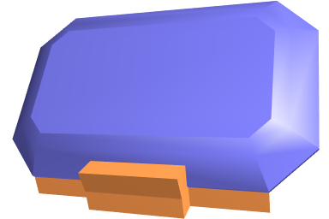
Synthesis of Snapping Fixtures
Use cases
Minimize surface exposure

Slide 9
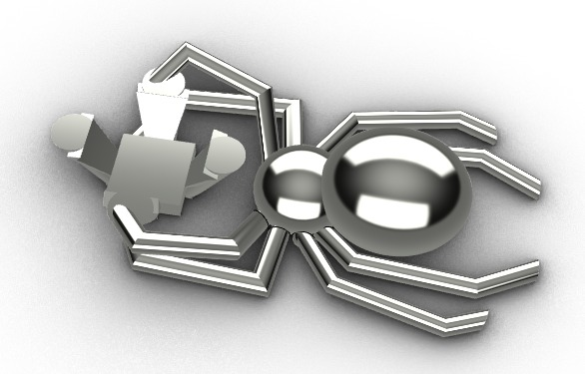
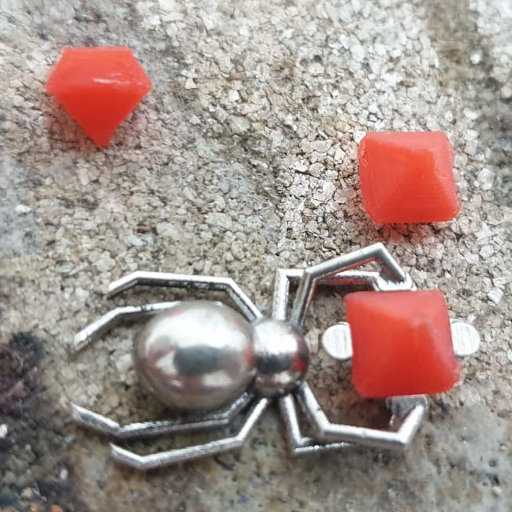
Synthesis of Snapping Fixtures
Use cases
Minimize surface exposure

Slide 10
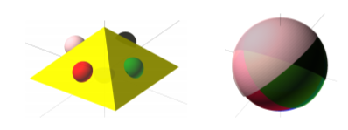
Synthesis of Snapping Fixtures
Definitions
Covering set approach

Slide 11
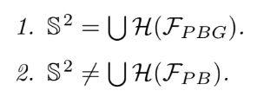
Synthesis of Snapping Fixtures
Definitions
Covering set approach
$$let F_{PBG} be the facets corresponds$$
$$to the palm, bodies and grippers$$
for a valid fixture, the following holds:
$$let H\left(F\right) be the unit open$$
$$hemispheres corresponds to F$$

Slide 12
Synthesis of Snapping Fixtures
Reservation

Slide 13
Synthesis of Snapping Fixtures
Goal
Generate the defined fixture for a given polyhedron if exists.
Minimize the number of fingers.

Slide 14
Synthesis of Snapping Fixtures
Properties

Slide 15
Synthesis of Snapping Fixtures
Properties

Slide 16
Synthesis of Snapping Fixtures
Properties

Slide 17
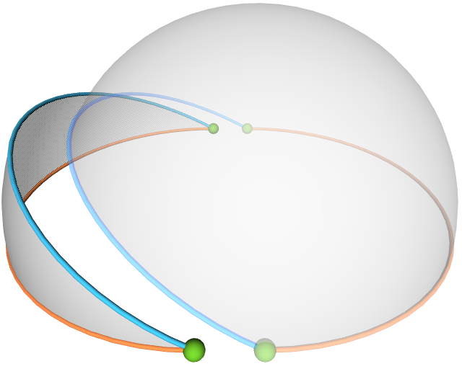
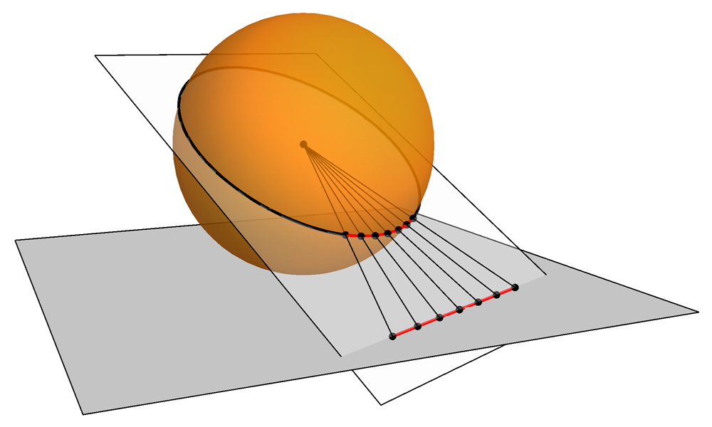
Synthesis of Snapping Fixtures
Properties

Slide 18
Synthesis of Snapping Fixtures
Properties

Slide 19
Synthesis of Snapping Fixtures
Properties

Slide 20
Synthesis of Snapping Fixtures
Properties

Slide 21
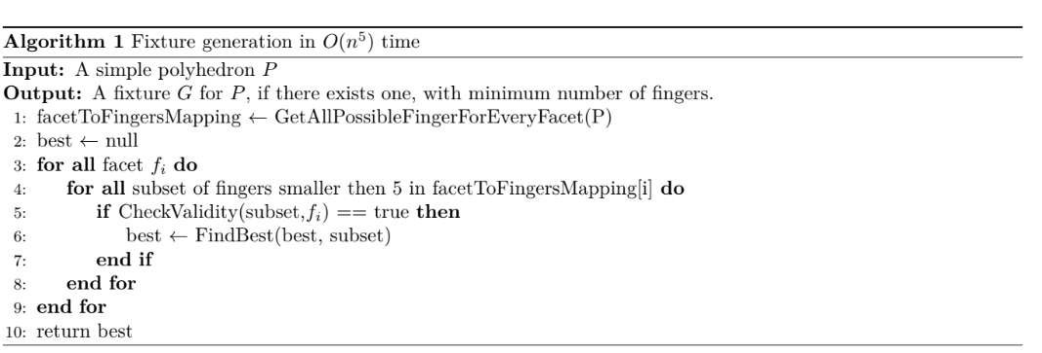
Synthesis of Snapping Fixtures
Algorithm

Slide 22
Synthesis of Snapping Fixtures
Algorithm
Are there more efficient algorithms?

Slide 23
Synthesis of Snapping Fixtures
Algorithm
Are there more efficient algorithms?
When someone asks you to improve the time complexity of your algorithm
yes
O (no)

Slide 24
Synthesis of Snapping Fixtures
Improvements
2 fingers fixtures in O($n^{3}$)
3 fingers fixtures in O($n^{3}$)
4 fingers fixtures in O($n^{3}$)

Slide 25
Synthesis of Snapping Fixtures
Improvements
2 fingers fixtures in O($n^{3}$) - trivial
3 fingers fixtures in O($n^{3}$)
4 fingers fixtures in O($n^{3}$)

Slide 26
Synthesis of Snapping Fixtures
Improvements
3 fingers fixtures in O($n^{3}$)

Slide 27
Synthesis of Snapping Fixtures
Improvements
3 fingers fixtures in O($n^{3}$)
body
body
body
palm
palm
palm

Slide 28
Synthesis of Snapping Fixtures
Improvements
body
body
body
palm
palm
palm

Slide 29
Synthesis of Snapping Fixtures
Improvements
3 fingers fixtures in O($n^{3}$)
$$\#triplets_considered≤\left({n \atop 3}\right)⋅2$$

Slide 30
Synthesis of Snapping Fixtures
Improvements
4 fingers fixtures in O($n^{3}$)

Slide 31
Synthesis of Snapping Fixtures
Improvements
4 fingers fixtures in O($n^{3}$)

Slide 32
Synthesis of Snapping Fixtures
Improvements
Are there more efficient algorithms?

Slide 33
Synthesis of Snapping Fixtures
Improvements
Are there more efficient algorithms?
no

Slide 34
Synthesis of Snapping Fixtures
Thank you

